Slide 1
Healthcare: Strokes Data Analysis
1

Slide 2



Our Team
Aspiring Data Analysts
Maria Vasileiadou
Eirini Nterou
B.Sc. Computer Science
Professional Experience in
Financial Services
as a Financial Crime Investigator
B.Sc. Statistics & Insurance Science
Professional Experience in Maritime and Insurance Sector
Some Experience in Video Editing and Computer Graphics
2

Slide 3


Studied factors that can cause stroke:
S T R O K E :
2nd Main Cause of Death WorldWide
11 % of the Total Deaths
Age
Gender
Hypertension
Heart disease
Smoking status
Residence type
Work type
Ever married
Avg glucose level
BMI
Stroke
SOURCE: Data Science Platform
3

Slide 4
Our workflow of the project
01
02
03
04
Data Preprocessing
and Cleaning
Exploratory Data Analysis
(EDA)
Data Visualization using MatPlotLib, Plotly and Seaborn
Interactive Visualization (Dashboard) in Power BI
4

Slide 5
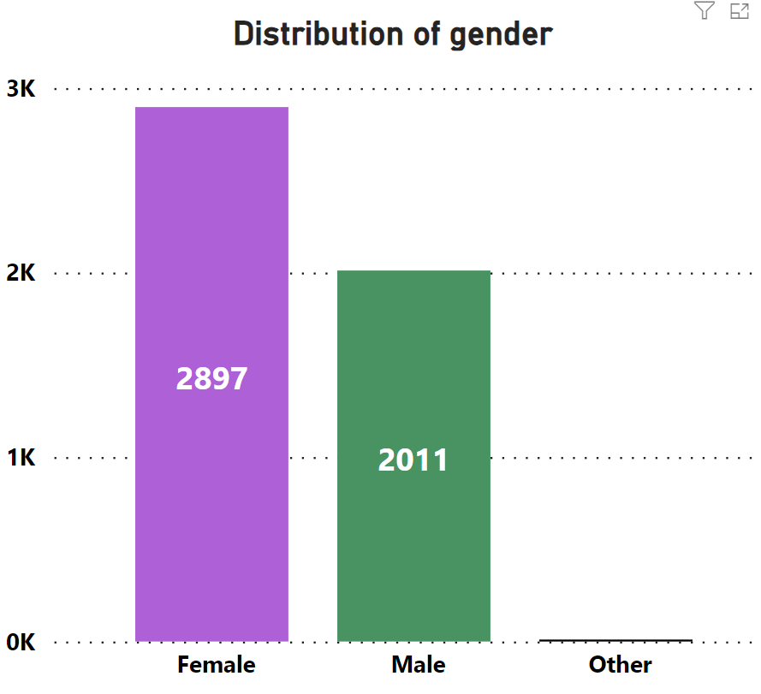
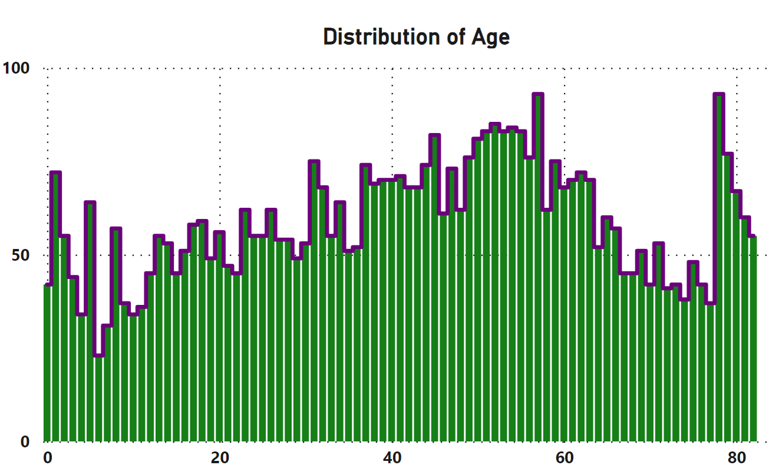
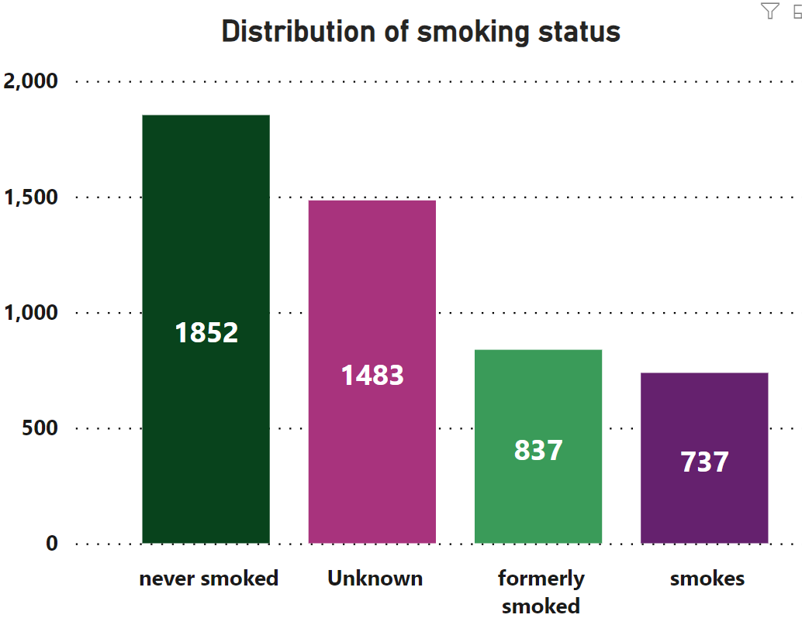
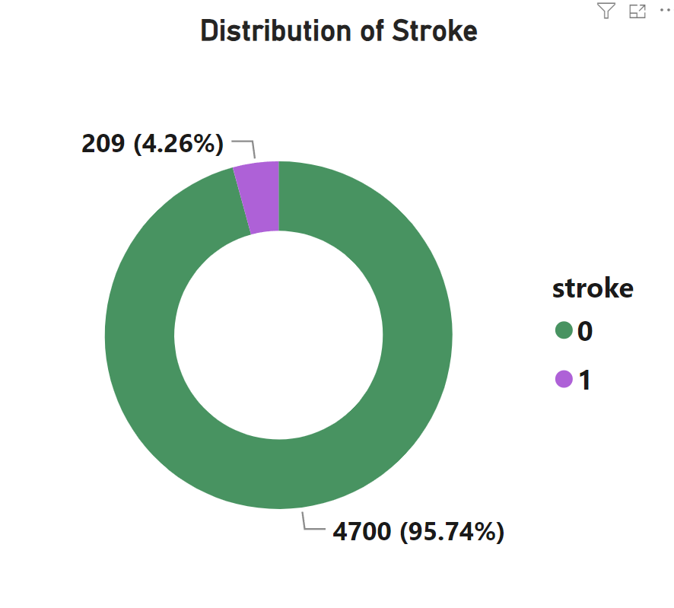
4,909 patients
4073 Adults
836 Children
209 suffered a stroke
5

Slide 6
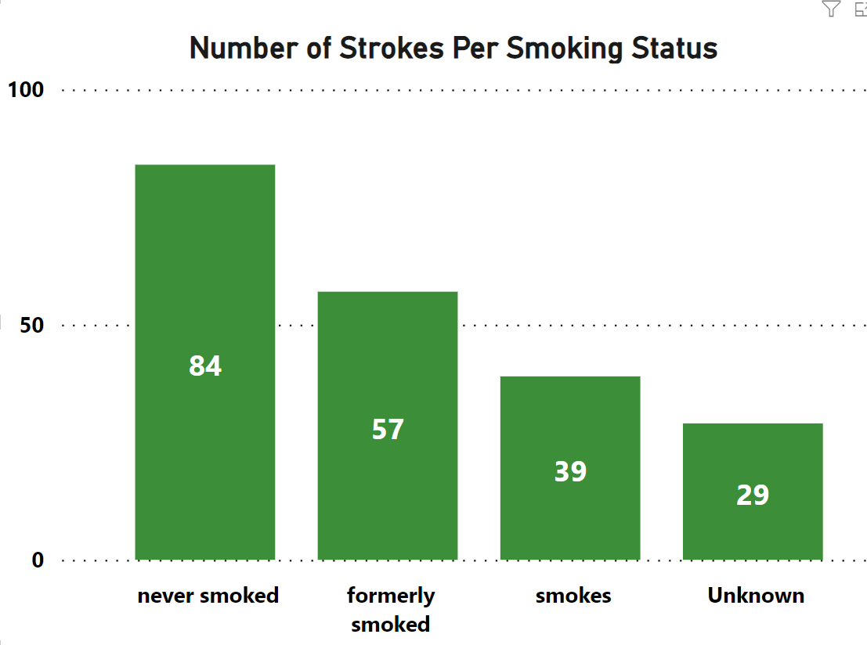
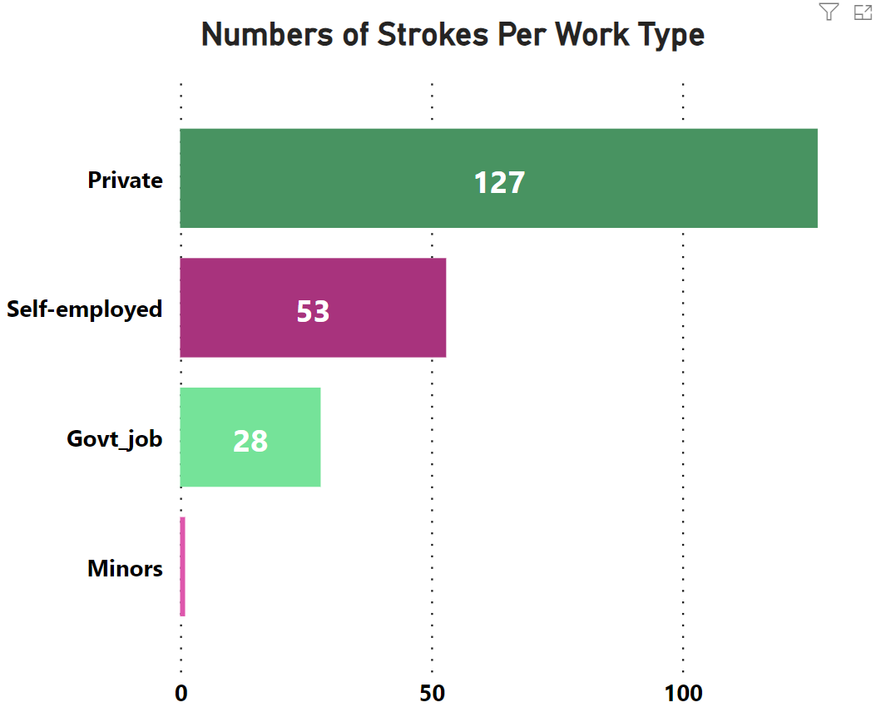
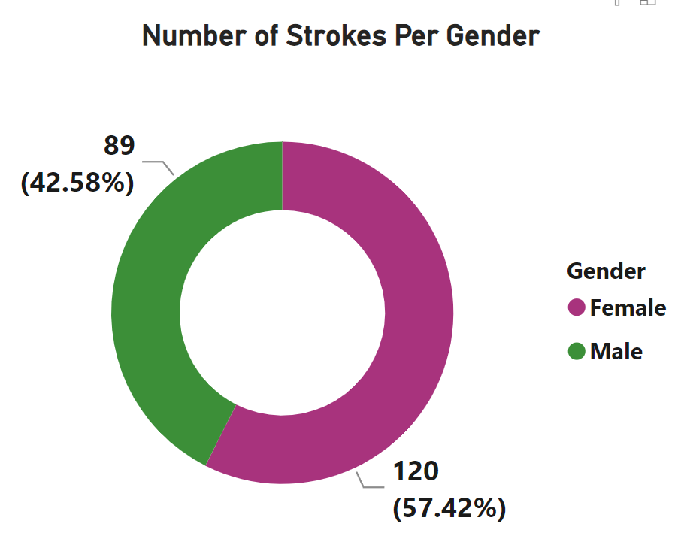
6

Slide 7
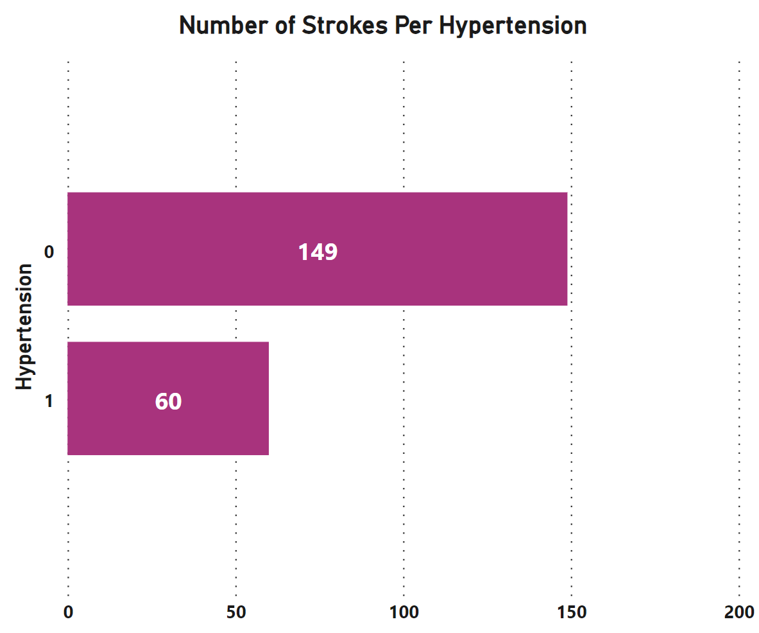
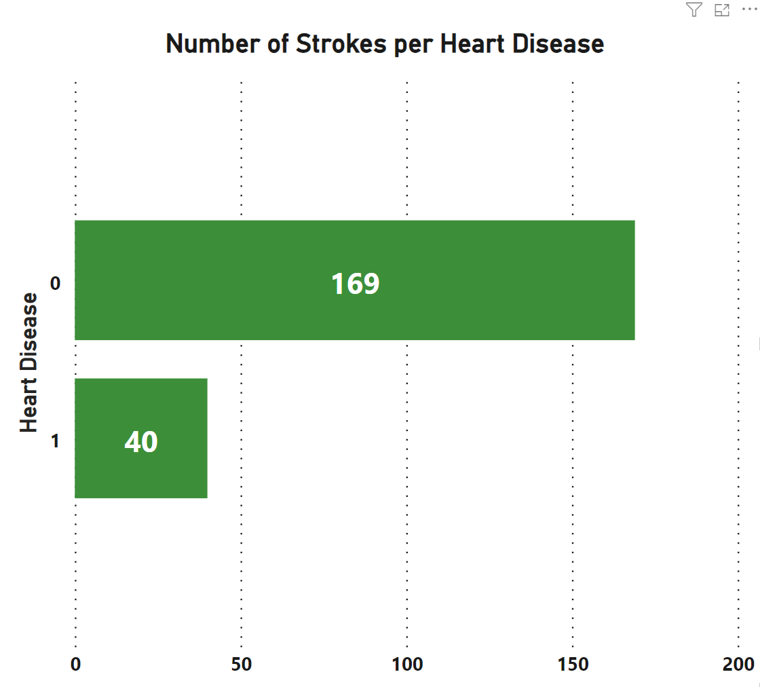
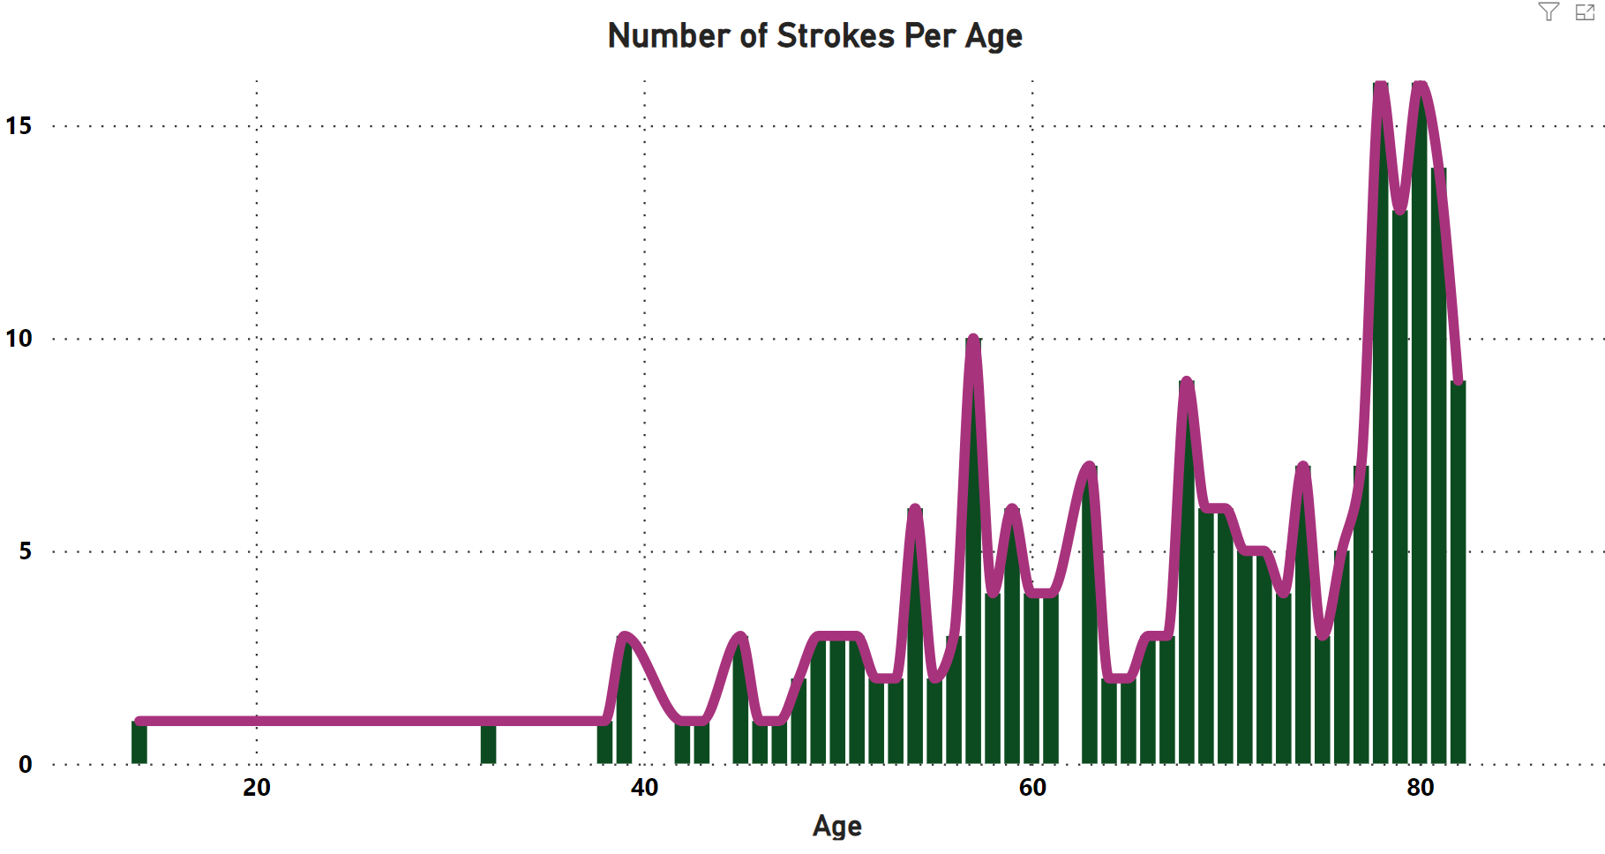
7

Slide 8
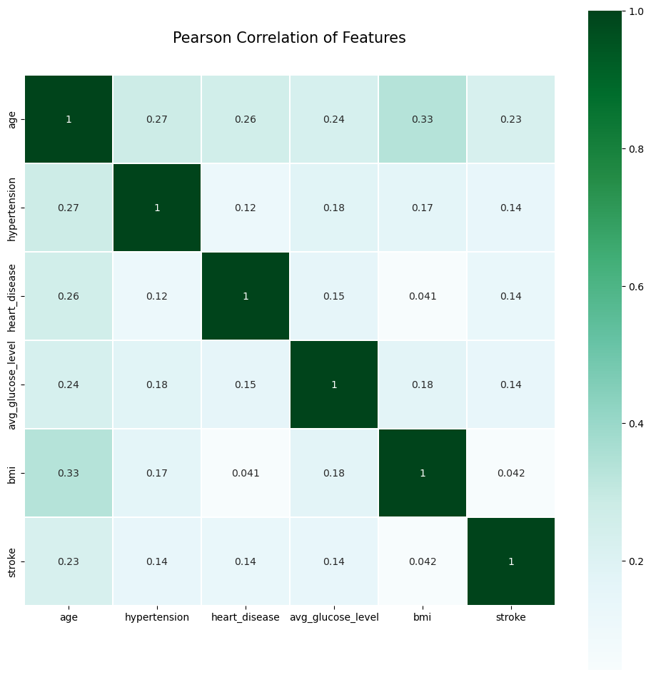

02
Discussion
You could enter a subtitle here if you need it
8

Slide 9

Conclusions
Age is lightly more correlated to strokes
No other factor seems to play an important part
Funds needed for more analytical procedures for sufficient and statistical significant conlclusions
9

Slide 10



Thanks
Do you have any questions?
Maria Vasileiadou
Eirini Nterou
10

